Slide 1

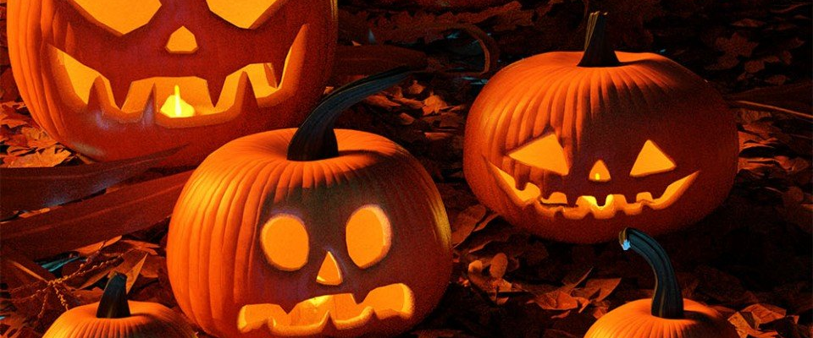
Game Proposal
Midnight Blood
Fred

Slide 2
Midnight Blood – Description
You play as a vampire who dwells within a small gothic town. At night, you must go out, stalk, and consume enough victims so you do not starve, however, you must return home before the sun rises. If you are seen killing a victim, or a victim sees you and gets away, authorities will be called on you. If they find you, they will shoot you with silver bullets and you will die and lose. If you are outside when the sun rises, you die and lose.
Notes:
Stalking added during interview.

Slide 3
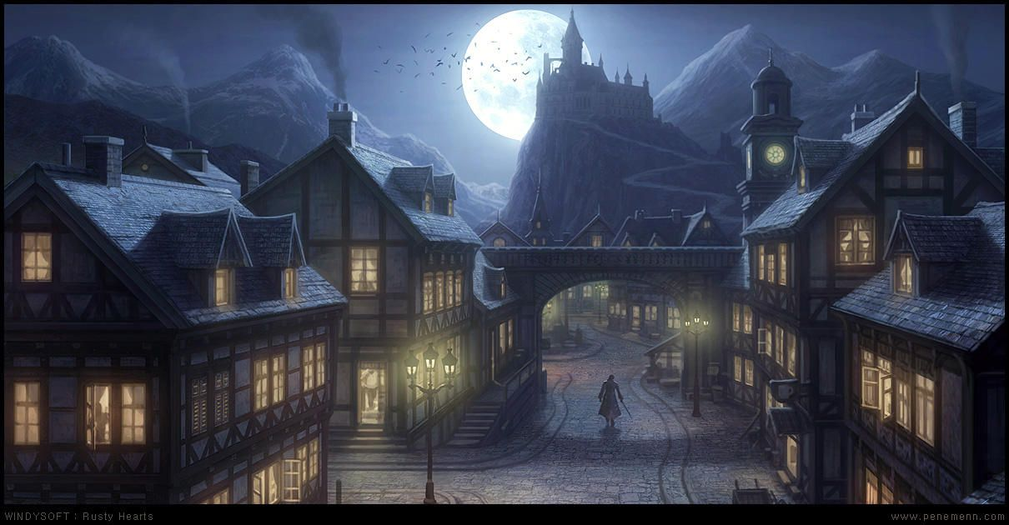
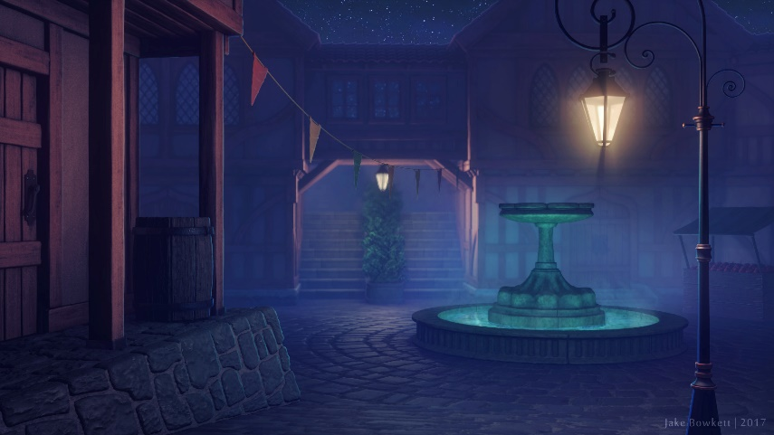
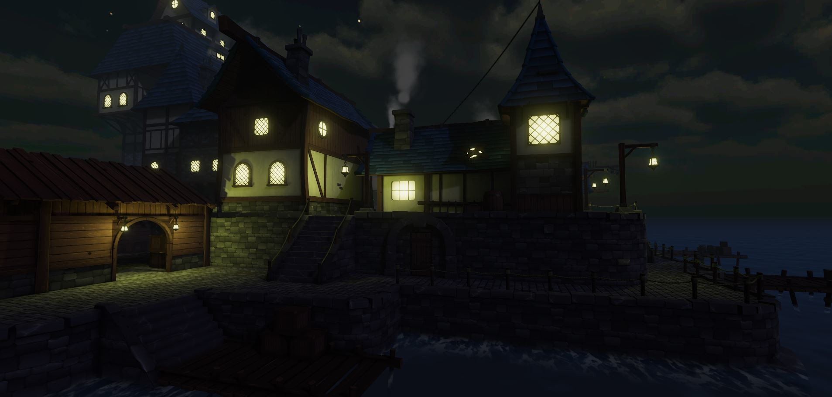
Midnight Blood – Mood Board
Notes:
Gameplay related image requested by jared in interview.

Slide 4
Midnight Blood – Core Pillars (Unique Selling Points)
Stealth action
Stalking prey, predator role.
Time limit pressure
Gothic / Fantasy theme (suitable for Halloween)
Immersion as a vampire
Notes:
Arcade feel corrected from arcade scores, less misleading. (from jared interview)
Arcade feel removed. Leaves more room for creativity. (from jared interview)
Stalking prey added during interview.

Slide 5
Midnight Blood – Anything Else

Slide 6

Questions?

